Slide 1
Data Acquisition System
Chapter 7

Slide 2
Data Acquisition
The process of collecting the input information as rapidly, accurately, economically and completely as necessary.
A typical data acquisition system consists of individual sensors with the necessary signal conditioning, data conversion, data processing, multiplexing, data handling and associated transmission, storage and display systems.

Slide 3
Data Acquisition System
DAS is used to measure and record signals obtained in basically two ways:
  Signal originating from direct measurement of electrical quantities which may include DC and AC voltage, frequency or resistance.
  Signal originating from transducers.

Slide 4
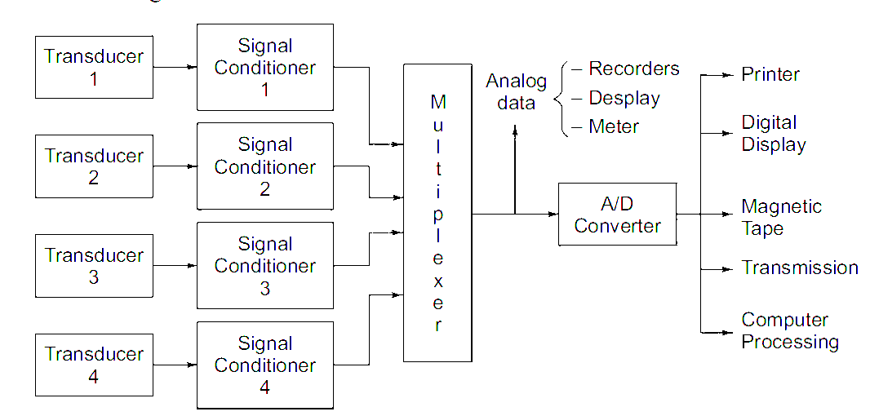
Data Acquisition System

Slide 5
Configuration of DAS
Factors affecting the configuration of DAS:
  Resolution and accuracy
  Number of channels to be monitored.
  Sampling rate per channel.
  Signal conditioner requirement per channel.
  Cost.
Two configurations:
  Single channel DAS
  Multi channel DAS

Slide 6
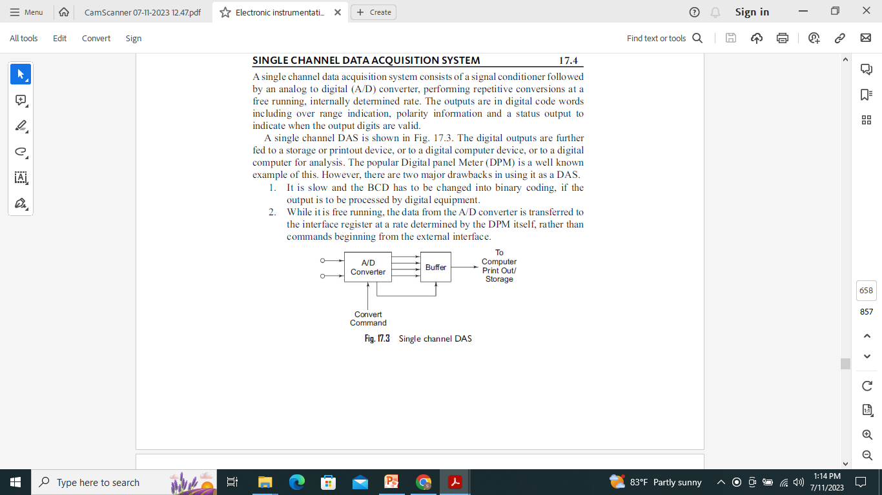
Single Channel DAS
It consists of signal conditioner followed by ADC.
Eg: Digital Panel Meter (DPM)
It is slow and BCD o/p must be converted to Binary if processed by digital equipments.

Slide 7
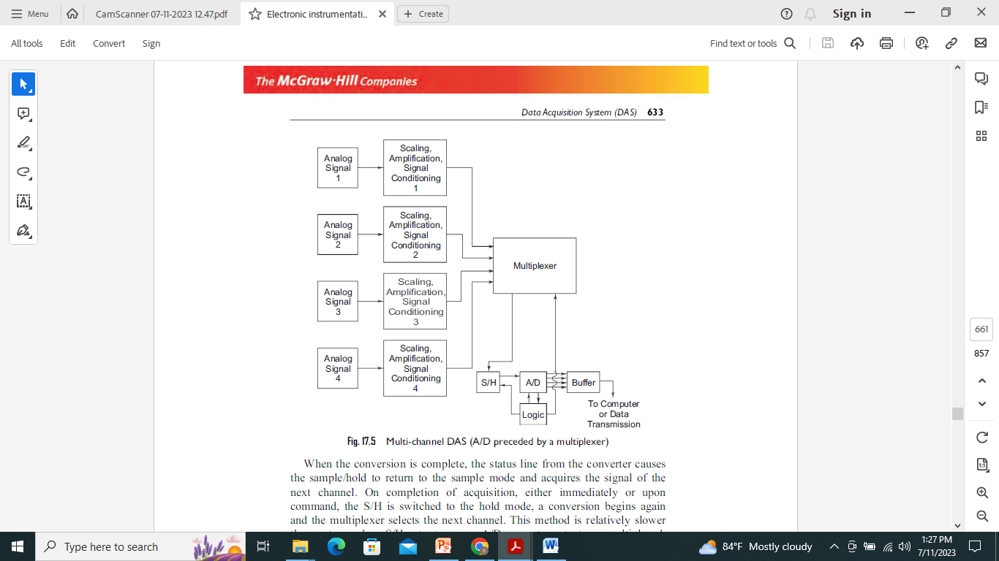
Multi Channel DAS
Individual analog signal applied to MUX thru signal conditioner.
Converted to digital form by ADC sequentially.
To make it more faster, the multiplexer takes the i/p thru next channel while the previous data stored in sample and hold ckt is converted into digital.
When conversion completed, S/H ckt returns to sample mode and acquires the signal of next channel.

Slide 8
Data Acquisition System
As instrument may be either analog or digital systems, correspondingly we have two types of DAS:
  Analog Data Acquisition System
  Digital Data Acquisition System

Slide 9
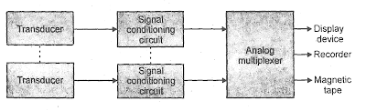
Analog DAS
The block diagram of analog DAS:
Components: Transducer, Signal Conditioner, Analog Multiplexer and Analog Recorders.

Slide 10
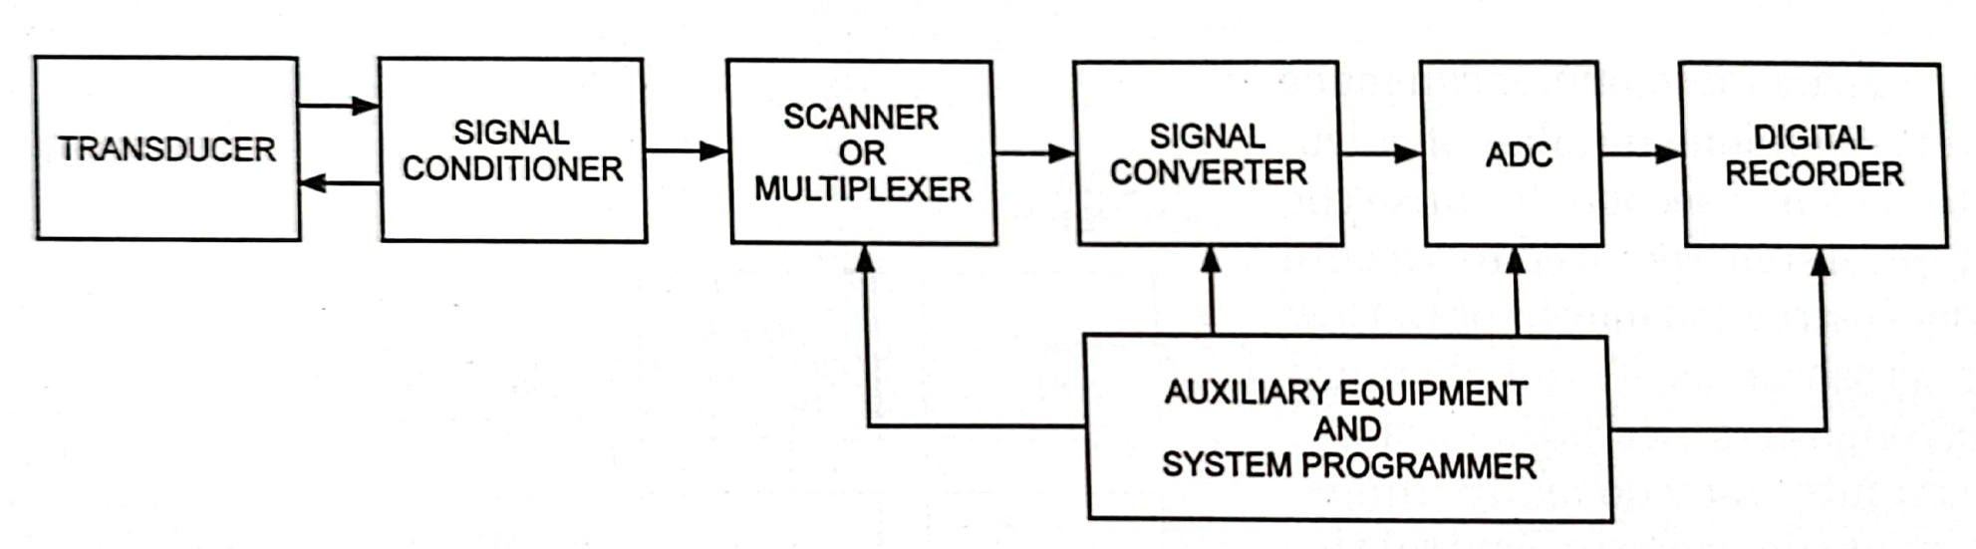
Digital DAS
The block diagram of digital DAS is :

Slide 11
Digital DAS
Mainly, the following operations take place in digital data acquisition.
  Acquisition of analog signals.
  Conversion of analog signals into digital signals or digital data.
  Processing of digital signals or digital data.
Components:
  Transducer, signal conditioner, MUX, ADC, digital recorder.

Slide 12
Applications of DAS
Biomedical, aerospace, telemetry.
Analog DAS is used when wide bandwidth is required or when lower accuracy can be tolerated.
Digital DAS is used when there is narrow bandwidth, high accuracy and low per channel cost is required.
The complexity of digital DAS range from single channel DC voltage measuring and recording to automatic multi channel system which measures a large parameters, compare them and provide decision.
Digital DAS is more complex than analog DAS in both instruments involved and volume and complexity of i/p data they can handle.

Slide 13
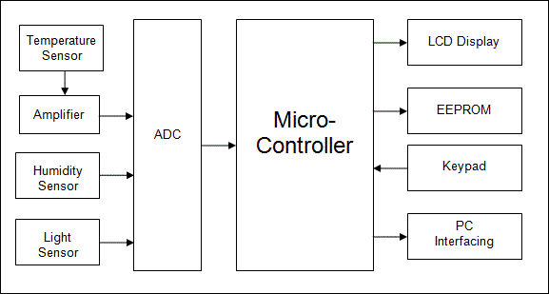
Modern trends in DAS
Microcontroller based DAS

Slide 14
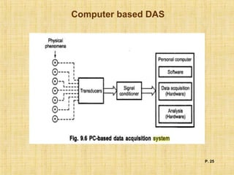
Modern trends in DAS
PC based DAS:

